Slide 1

Technology Fundamentals
Course Introduction
SoftUni Team
Technical Trainers
Software University
https://softuni.bg/

Slide 2
Table of Contents
Course Objectives
Training and Team
Course Organization
Course Infrastructure
Evaluation Criteria

Slide 3
Have a Question?
sli.do
#fund-java

Slide 4













SoftUni Diamond Partners

Slide 5

Course Objectives

Slide 6
Java Fundamentals Objectives
Working with linear data structures
Arrays and Lists
Defining simple classes
Processing and manipulating strings
Regular Expressions
Building simple web project

Slide 7
Practical Programming Exam
Mid Exam
3 practical problems for 4 hours
Conditional Statements and Loops
Linear Data Structures – Arrays and Lists
Final Exam
3 practical problems for 4 hours
Strings and Text Processing
Associative Arrays
Regular Expressions

Slide 8
Theoretical Exam
You will have 30 minutes once you enter
Multiple choice with only 1 correct answer
English
Automated quiz system
Available online on the day of the practical exam
You can submit your answers just one time

Slide 9

The Team

Slide 10
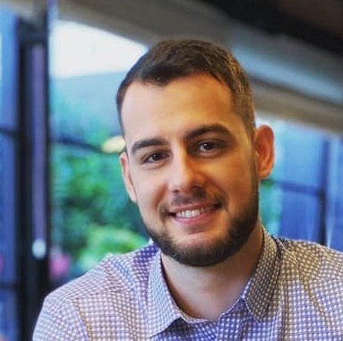
Dimo Georgiev
Software Developer @ SAP
Oracle Certified Java Professional
Computer and Software Engineering at Technical university of Sofia

Slide 11
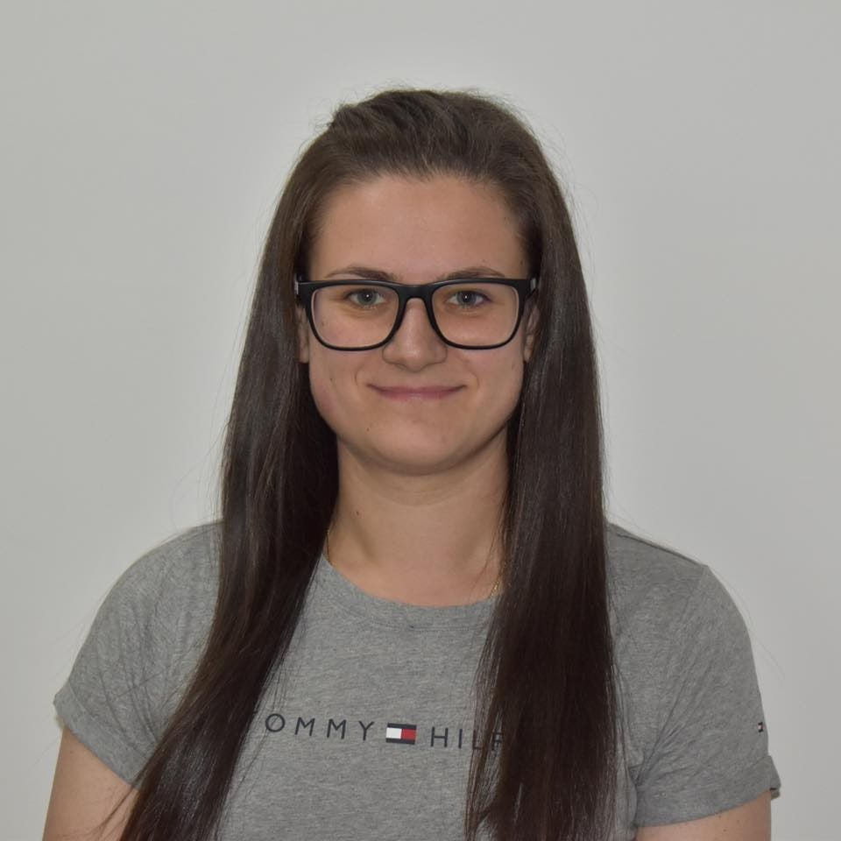
Desislava Topuzakova
Java Developer @ SAP
Ex-Competitor with Mathematics
Technical Trainer @ SoftUni
Programming Basics Team Lead
Content Development Team Lead @ SoftUni

Slide 12

Course Organization

Slide 13
Java Fundamentals Module
11-Jan-2021
27-Feb-2021
03-Apr-2021
Java Fundamentals
12 weeks * 3 times / week
18 credits
Start: 11-Jan-2021
Mid Exam: 27-Feb-2021
Theoretical exam: 03-Apr-2021
Final exam: 03-Apr-2021
Re-Take Exams
Mid Exam Retake: 06-Apr-2021
Theoretical Exam: 09-Apr-2021
Final Exam Retake: 09-Apr-2021

Slide 14

Homework Assignments & Exercises
Your homework is mainly work in class
Lesson days → slides + live demos + exercises
Exercise days → only exercises
How to submit your homework?
Submitted in the judge system
Do your homework when it's due
Assignments pile up quickly

Slide 15


SoftUni Certificate
Practical Exam 100%
Homework 5%
Evaluation
15

Slide 16
CPE Certificate
Theoretical Exam 100%
Evaluation
16

Slide 17



Java Advanced Course, Forum and FB Group
Official web site:
Official discussion forum:
Official Facebook group:
Community Facebook group:
https://softuni.bg/trainings/3212/java-fundamentals-january-2021
softuni.bg/forum/categories/44/
https://www.facebook.com/groups/javafundamentalsjanuary2021
https://www.facebook.com/groups/SoftUniJavaCommunity/

Slide 18
Questions?
Notes:
18

Slide 19
Trainings @ Software University (SoftUni)
Software University – High-Quality Education, Profession and Job for Software Developers
softuni.bg, about.softuni.bg
Software University Foundation
softuni.foundation
Software University @ Facebook
facebook.com/SoftwareUniversity
Software University Forums
forum.softuni.bg
Notes:
19

Slide 20

License
This course (slides, examples, demos, exercises, homework, documents, videos and other assets) is copyrighted content
Unauthorized copy, reproduction or use is illegal
© SoftUni – https://about.softuni.bg/
© Software University – https://softuni.bg
Notes:
20

